Slide 1
Data Management Application
We Can Do It Team

Slide 2
About Us
Dhari - Mobile / Backend Development
Abdulrahman - UI/UX
Elina - Database Development
Andrew - Front end Development

Slide 3
About the app
This is a data management application that will make it easier for Police officers to send important documents and links to citizens/victims when crimes are reported.

Slide 4
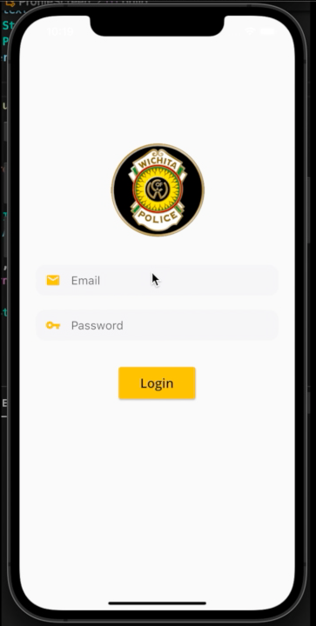
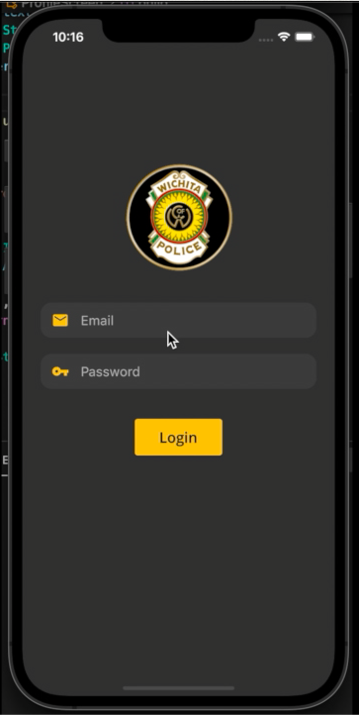
Light and Dark Modes

Slide 5
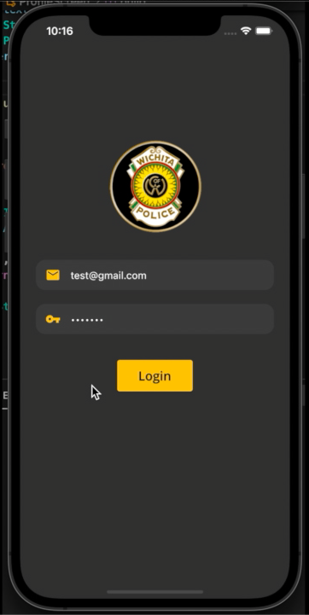
Login screen
Two types of roles/credentials:
Police
test@gmail.com
1234567
Regular permissions
Admin
admin@gmail.com
1234567
Can delete and add users

Slide 6
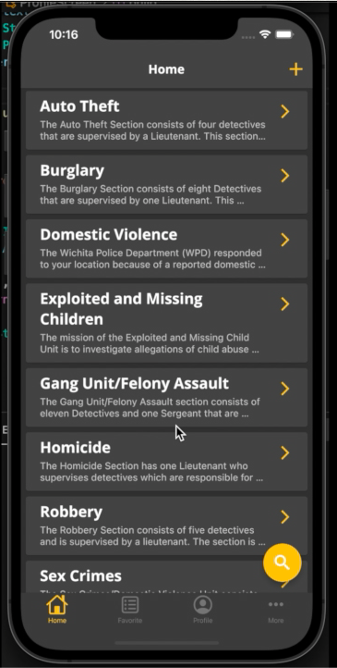

Home Screen
Add case
Open case
Search cases
Home
Profile
Favorite
More

Slide 7
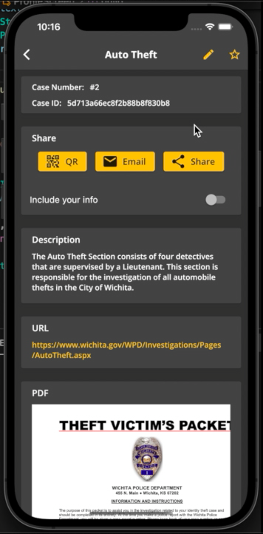
Home Screen - Open Case
Edit case
Favorite case
Share options:
QR
Email
Other apps
Include officer contact info
Link to WPD website for case
Preview of PDF

Slide 8
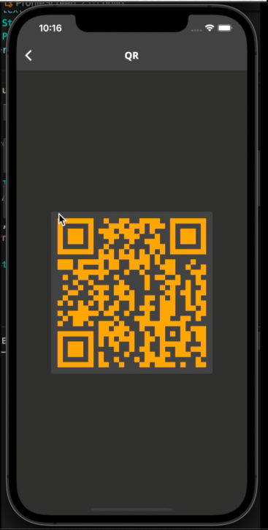
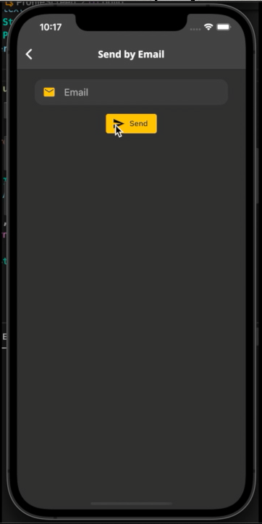
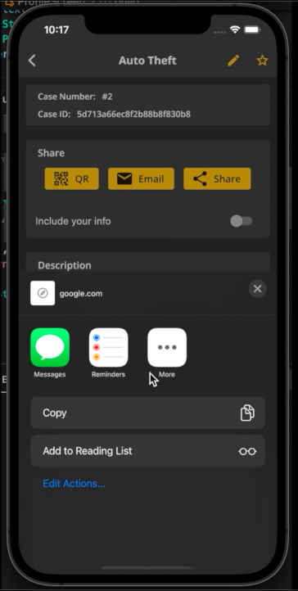
Share options

Slide 9
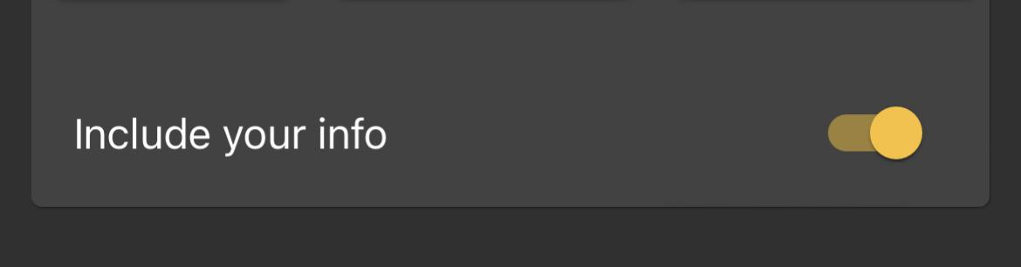
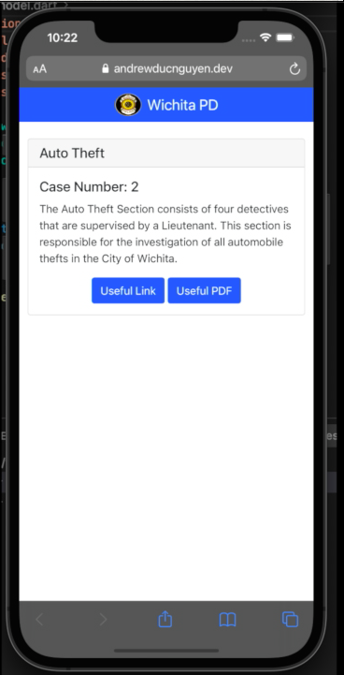
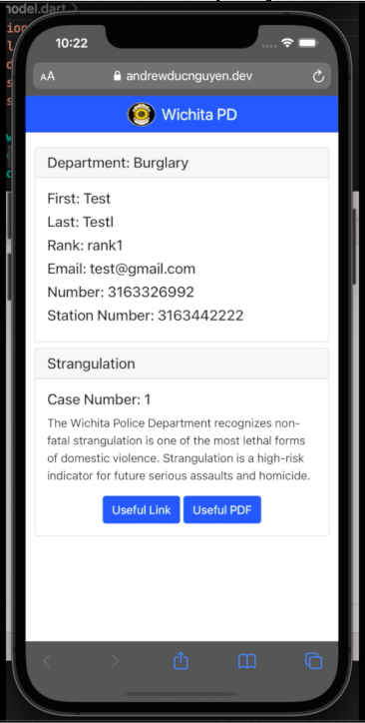
QR Code

Slide 10
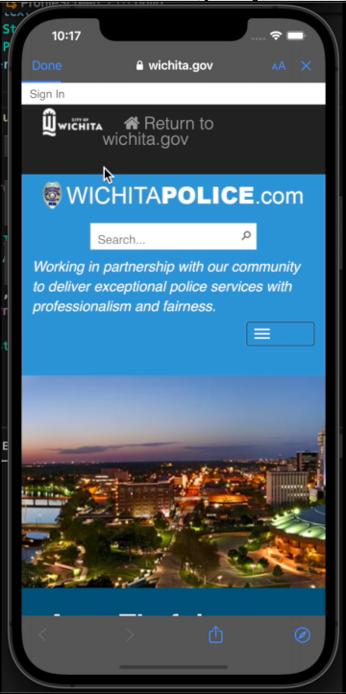
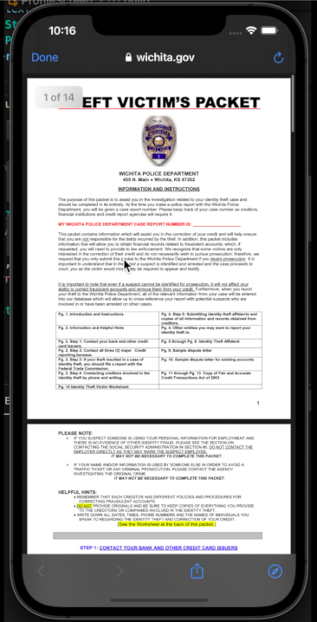
Link to WPD website for case
PDF

Slide 11
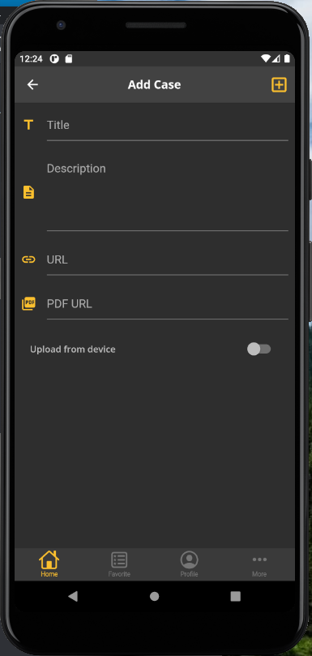
Home Screen - Add Case
Click to add case when you are done

Slide 12
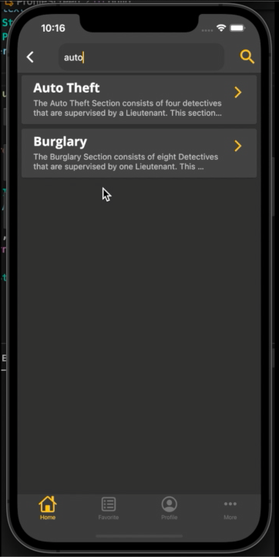
Home Screen - Search Cases
Click to search after typing
It will search for the word in the title and the description.

Slide 13
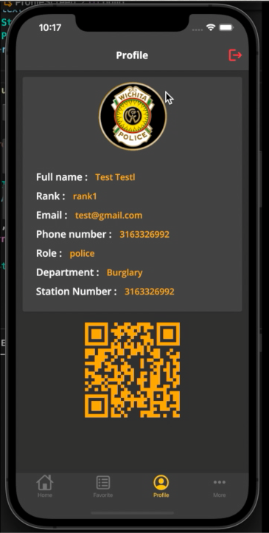
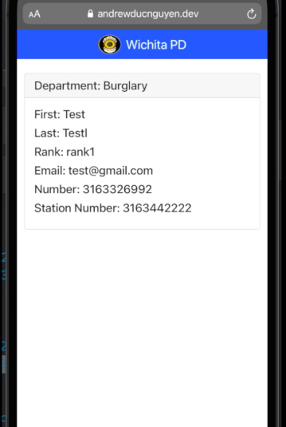
Profile screen

Slide 14
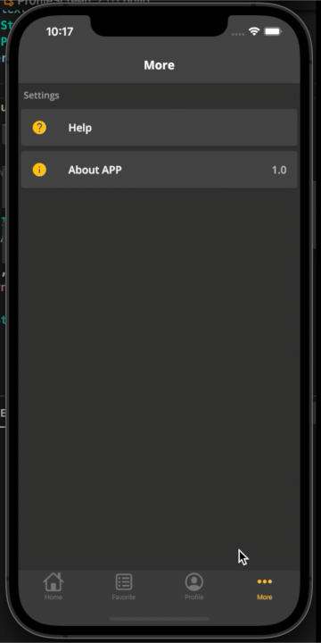
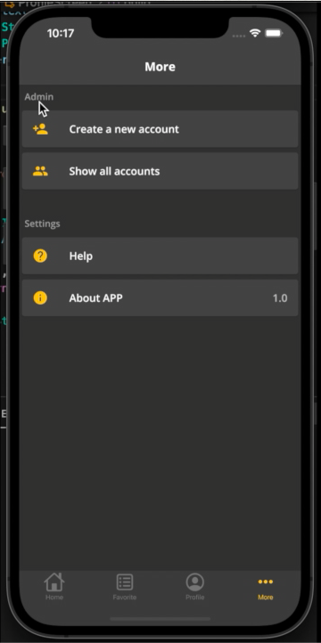
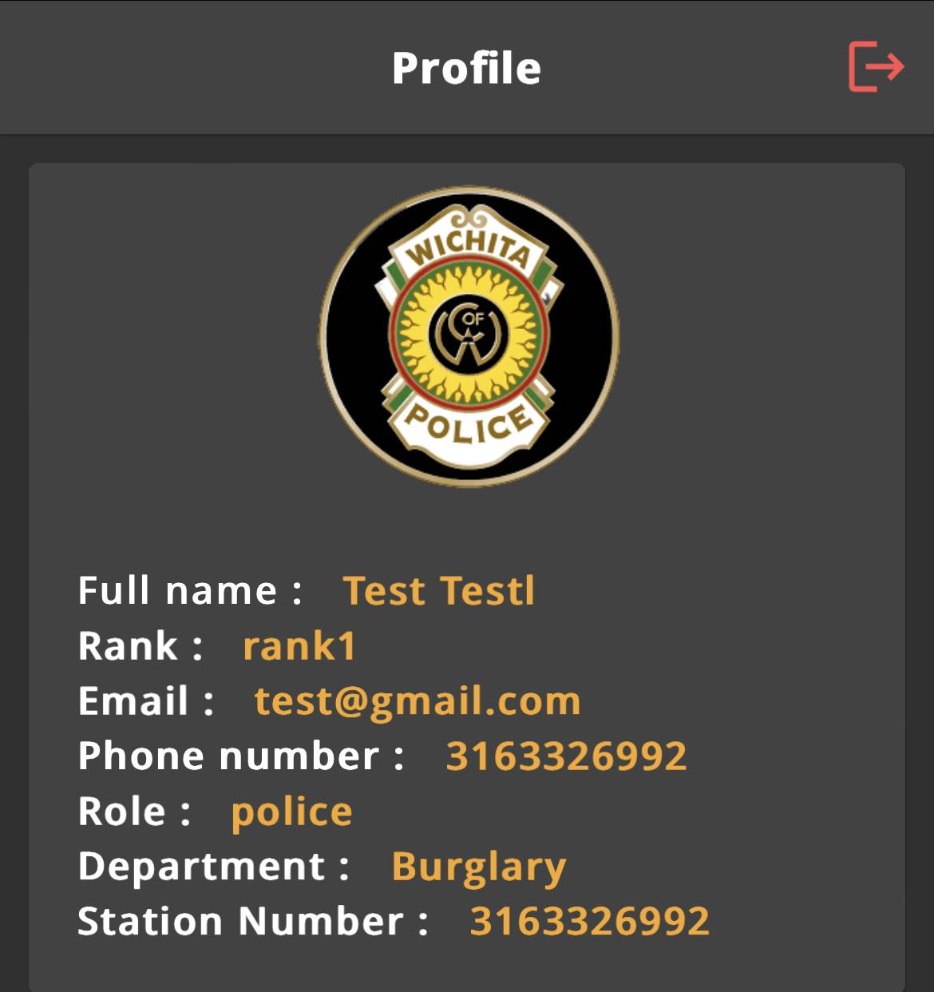


Slide 15
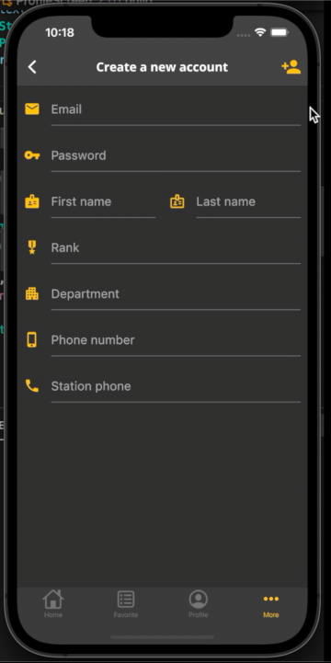
More Screen - Create new account
Click to add account when you are done

Slide 16
What we are working on
1 - Favorites feature
2 - Offline database
3 - Automatic translation

Slide 17

COST
Plan | Standard | High traffic
App Platform | $25 - $50 /mo | $75 - $250 /mo
Managed Databases | $15 - $30 /mo | $45 - $120 /mo
Sendgrid | $15 - $30 /mo | $90 - $200 /mo
Onesignal | $9 /mo | $9 /mo
Total | $64 - $119 /mo | $219 - $399 /mo

Slide 18

Thank you
Any questions, comments, concerns?

